Slide 1

TRENDS IMPACTING CHURCHES AND CHRISTIAN MINISTRY
Presbyterian Assembly Brisbane 2016 Tim Dyer – The Johnmark Extension

Slide 2



DEMOGRAPHICS
CHRISTIANITY IN AUSTRALIA
Christianity No Religion Other Religions
CHRISTIANITY AND
SPIRITUALITY
More Spirituality than Christianity More Christianity than Spirituality
7.5
ACTIVE INVOLVEMENT
Not active occasional attendance Active Regular Participation
31.5
23
61
30
38
9
Source: Mark McCrindle Demographic Snapshot 2014

Slide 3
CHURCH ATTENDANCE
Relative Percentage in each cohort
25
20
15
10
5
0
15-19
20-29
30-39
Church Attenders
40-49 50-59
Poly. (General Population)
60-69 70+
Poly. (Church Attenders)
General Population
Source: ABS, NCLS, McCrindle Christianity in Australia 2012

Slide 4
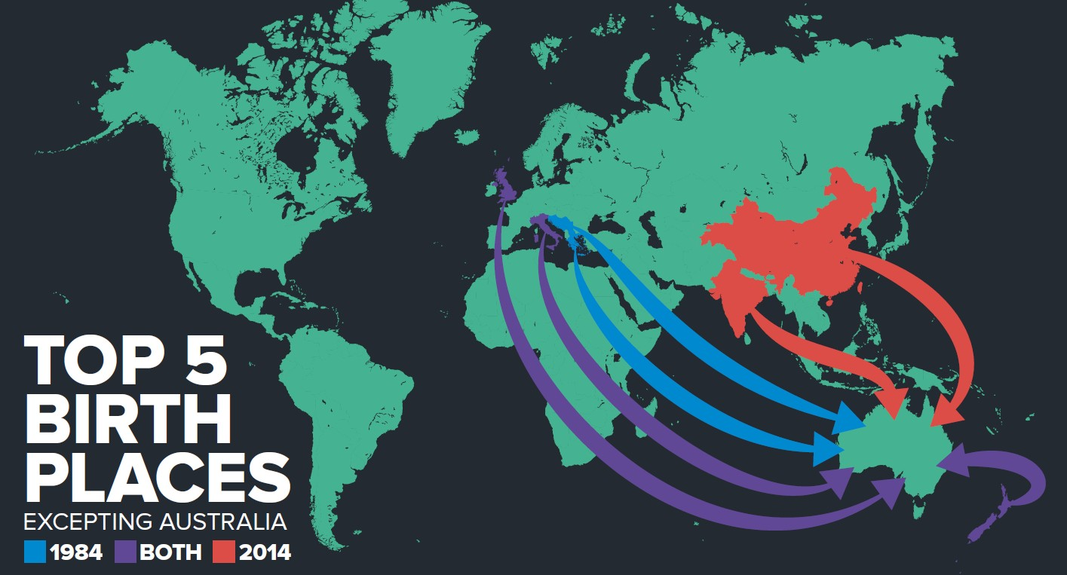
CHURCH ATTENDANCE IS INCREASINGLY MULTICULTURAL
Source: Mark McCrindle Australia Then and Now 2014

Slide 5













REASONS AUSTRALIANS DON’T
ATTEND CHURCH
50
47
45
40
35
30
26
25
24
22
20
19
18
15
10
5
0
Church is irrelevant
I don't agree with the teaching
Outdated style
I have problems with the clergy
I don't believe the bible
Too busy
Source: Mark McCrindle Church Attendance in Aus 2013

Slide 6
ATTITUDES TO CHURCH
88% of non-attenders see the church as somewhat beneficial to society in general
Less than ½ of this group do not see any personal
benefit in what the church offers
Faced with choices about what services they value and benefits they see in various community programs and facilities, church ranks near the bottom of the list
Source: Mark McCrindle Church Attendance in Aus 2013

Slide 7
CHANGING ATTITUDES TO CHURCH
The average Australian increasingly sees the church as irrelevant to life and society. It has been tolerated because it does some good – especially in education, health and welfare. However….
Within the last 2-3 years, Christianity is increasingly seen as a potentially damaging religion that should not be publicly promoted within an educated and civilised society (i.e Challenges to Religious Instruction in state schools)

Slide 8
ATTITUDES TO TERMS DESCRIBING
CHRISTIANS
Practicing Christian + 28
Ordinary Christian + 18
Protestant Christian + 13
Born Again Christian - 5
Evangelical Christian - 11
Fundamentalist Christian - 31
Source: Mark McCrindle Church Attendance in Aus 2013

Slide 9
REASONS FOR THE SHIFT
All ‘fundamentalist’ sects are under suspicion of having
exclusive truth claims and of being potentially violent
Religion is seen to oppose a ‘self-evident’ positive progressive social agenda (sexuality & gender, ‘life’ issues)
The Royal Commission into Institutional Responses to Child Sexual Abuse has raised significant credibility issues for the Christian church
The loss of confidence and credibility is fuelled by popular Atheism

Slide 10
EVEN CHRISTIANS ARE ATTENDING
LESS OFTEN
Affluence, travel, Sunday as a social day
Kids, sport and children’s activities
Blended and single parent families
Self directed spirituality and online options
We are steadily losing the less engaged attenders and tending to keep those who are active participants and those with questions about faith
Source: Hugh McKay Beyond Belief 2016

Slide 11
FAITH ONLINE
The large attractional churches that grew towards the end of the last century built their communities through quality contemporary music and dynamic preaching – you attended to hear it
Technology has changed this model
The very best from around the world is now available whenever a person wants to connect in on any internet device – and they are…

Slide 12
POST MODERN PLURALISM
Significant loss of trust in key structures and institutions
  In any form of given truth
  Educational institutions including Universities
  Politics and the political system
  Religious systems and institutions
Spirituality is in – the church as an institution is out

Slide 13
INCREASED INDIVIDUALISM
Changes in consumer mass marketing (Hugh McKay)
  Everything is about the individual and the right to be well off, happy and successful
  We do not owe society, others less well off, or those in need anything
  Look after your self and the world will look after itself

Slide 14
PASTORAL LEADERSHIP CRISIS
Levels of Emotional Exhaustion in Ministry
  Burnout and Stress
Conflicted churches
Loss of Meaning in Ministry
  Key leaders leaving ministry in mid-life

Slide 15
STATE OF CHURCHES AND
MINISTRIES
Most mainline denominations are closing more churches than they are opening
There is small growth in Pentecostal churches and in
some ethnic churches (Chinese)
Significant numbers of clergy continue leave ministry however there is an increase in the number of clergy training later in life as a second / third career

